Slide 1
RestauAnalytics
Dieudonne Ouedraogo
01/25/19

Slide 2
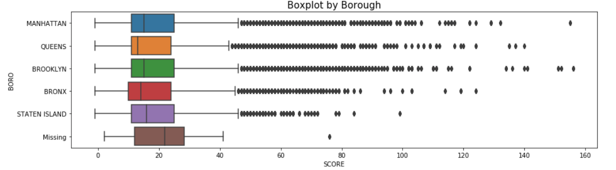
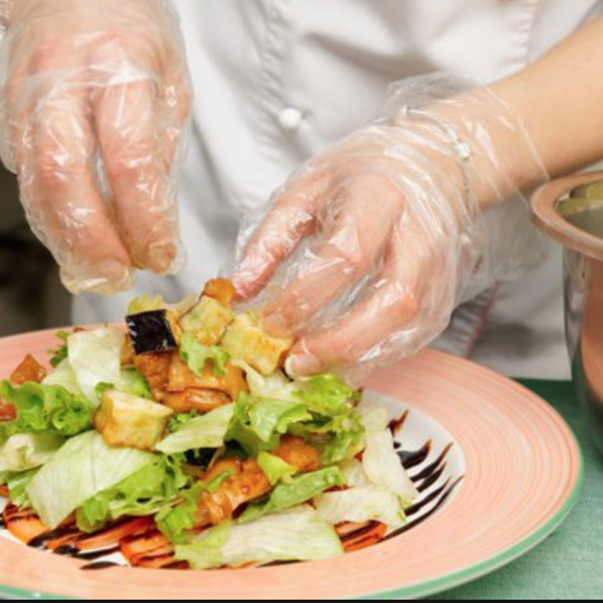
RestauAnalytics
Dieudonne Ouedraogo, Insight Data Science 2019A DS NY
RESTAUANALYTICS
01-25-2019
INSIGHT DATA SCIENCE
www.comany.com
1

Slide 3
Context
Food is intrinsically related to health, and having insights and transparency about the restaurants can save many lives.
RestauAnalytics aims to provide more clarity to users so they can have more confidence when choosing a restaurant.
Most people in NYC eat outside of their homes, restaurants provide for their needs. Even though the DOHMH monitor restaurants activities and provides grades, this informations is not enough to help people make a better decision when it comes to their food.
Insight Data Science
3

Slide 4
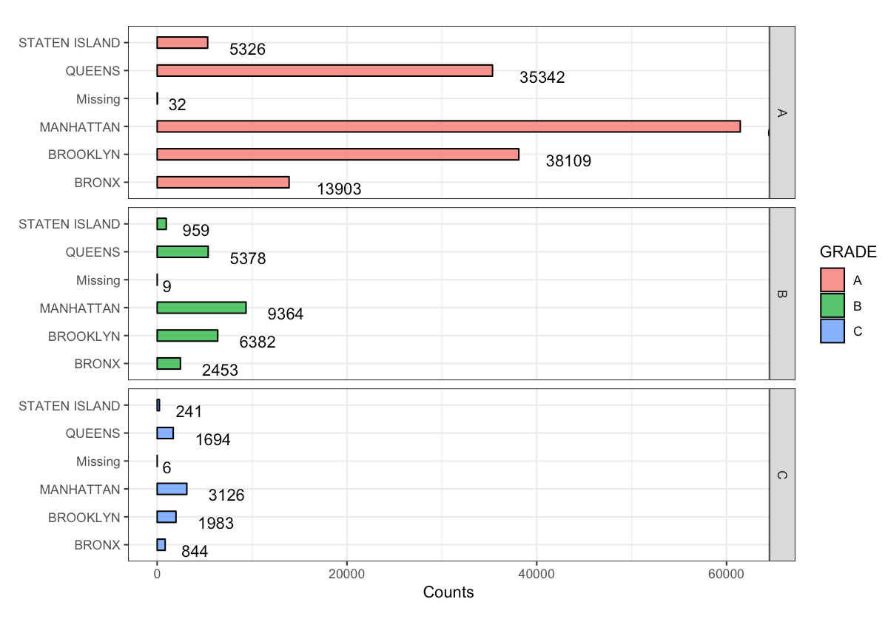
NEED
Finding actionable information about a particular restaurant.
Being able to predict future violation scores and critical issues(food poisoning) to support decision making
www.comany.com
1

Slide 5
VISION
Develop a user-friendly interactive application to provide insights.
Predict future score and the danger for a particular restaurant using supervised learning. Provide an application that extracts more meaning information providing easy decision making to the user.
Data source and acquisition:
The data used in the application was made available and updated on 1/21/2019 by DOHMH
Inspections Results dataset
2010-2017.

Slide 6
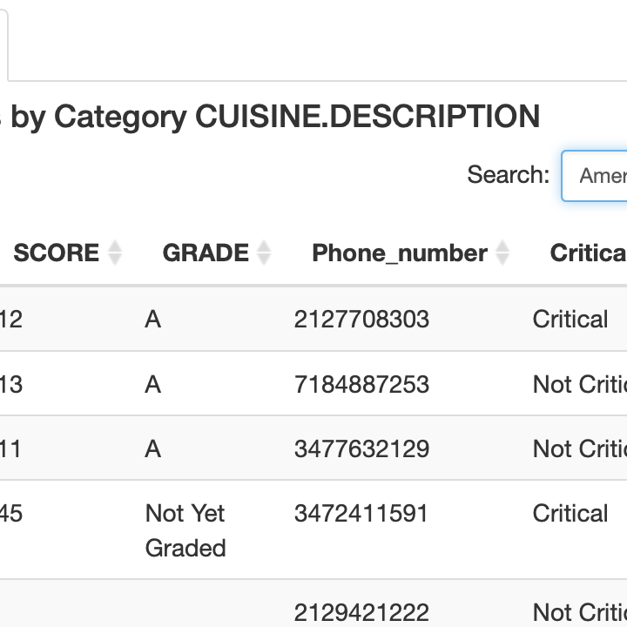
Feature Engineering
When the Department visit a restaurant, a score is given, we will call this score Vi.
V1 is the score at the first visit
Vn is the score at the nth visit
Models building
Given a particular n, the aim is to predict the score at the n+1 visit: Vn+1 using
supervised learning algorithms
Evaluations
Metrics

Slide 7
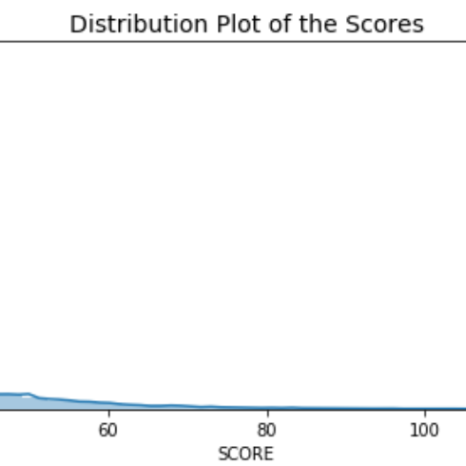
OUTCOME
An interactive application providing users metrics on restaurants
It is possible to go on RestauAnalytics and search a restaurant by grades and score and other characteristics and retrieve their address and phone numbers Beside transparency, RestauAnalytics will predict the probability of getting food poisoning at a particular restaurant in NYC. Predictions of future violations scores using supervised learning algorithms: Regression, SVM, Random Forest.

